Slide 1




Research Design

Slide 2
Recap

Slide 3

Learning Objectives
Describe the basic uses of exploratory research
Specify the key characteristics of exploratory research. Small scale and very flexible studies are used to generate ideas and insights
Discuss the various types of exploratory research and describe each
Identify the key person in a focus group
Discuss two major pitfalls to avoid with focus groups (or any other form of exploratory research).

Slide 4
Exploratory Research
Research conducted to gain ideas and insights to better define the problem or opportunity confronting a manager.
When conducted correctly, exploratory research should provide a better understanding of the situation and possibly yield hypotheses- but this kind of research is not designed to come up with final answers and decisions
Small scale
Flexible

Slide 5
Hypothesis
A statement that specifies how two or more measurable variables are related
Examples:
H1: Women are more likely than men to make impulse purchases of our brand
H2: Decreasing price by 10% will increase unit sales by 30%
H3: Adoption of our new product will be greater in Northern states than in Southern States

Slide 6
Why conduct exploratory research?
Develop hypotheses
Better formulate the manager’s decision problem
Increase researcher’s familiarity with the problem
Clarify concepts

Slide 7
Exploratory Research Types
Literature Search
Depth Interviews
Focus Groups
Data Mining
Case Analyses
Projective Methods

Slide 8
Literature search
A search of statistics, trade journal articles, other articles, magazines, newspapers, books, and/or online sources for data or insight into the problem at hand.

Slide 9
Depth Interviews
Interviews with people knowledgeable about the general subject being investigated
Some possibilities:
Those who work with it (e.g., employees, consultants)
Those who study (e.g., researchers, analysts)
Those who live it (e.g., consumers)

Slide 10
Focus Group
An interview conduct among a small number of individuals small number of individuals simultaneously; the interview relies more on group discussion than on directed questions to generate data

Slide 11
Characteristics of Focus Groups
Typically 8 to 12 people
1.5 to 2 hours in length
Homogenous within group; heterogeneity introduced across groups
Participants carefully screened
Session recorded and transcribed
Notes:
Traditional vs. online focus groups

Slide 12
Focus Group
Moderator
Individual that meets with focus group participants and guides the session
Moderator’s Guidebook
An ordered list of the general ( and specific) issues to be addressed during a focus group; the issues normally should move from general to specific.

Slide 13
Characteristics of Good Focus Group Moderators
Superior listening ability
Excellent short-term auditory memory
Well organized
A quick learner
High energy level
Personable
Well-above-average intelligence

Slide 14
The Dark Side of Focus Groups
Easy for managers to see what they expect to see in focus group results
Focus groups are on one form of exploratory research – They should not be expected deliver final results or answers to decision problems – yet many managers seem to use them for that purpose.

Slide 15
Normal Groups
Nominal groups
A group interview technique that initially limits respondent interaction while attempting to maximize input from individuals iudal group members.

Slide 16
Data Mining
The use of powerful analytic technologies to quickly and thoroughly explore mountains of data to obtain useful information
Although most forms of exploratory research are qualitative in nature, data mining involves sophisticated quantitative analysis of data held in a company’s databases
Notes:
1-800-flowers.com used data mining to develop successful promotions after discovering that professional, suburban moms were a key demographic for them.

Slide 17
Case Analyses
Intensive study of selected examples of the phenomenon on interest
Notes:
Especially effective with cases reflecting
Recent change
Extremes of behavior
The “best” and “worst” situations

Slide 18
Ethnography
The detailed observation of consumers during their ordinary daily lives using direct observations, interviews, and video and audio recordings

Slide 19
Benchmarking
Using organizations that excel at some functions as sources of ideas for improvement.

Slide 20
Projective Methods
Methods that encourage respondents to reveal their own feelings, thoughts, and behaviors by shifting the focus away from the individual through use of indirect tasks.
Word association
Sentence completion
Storytelling
Role Playing

Slide 21
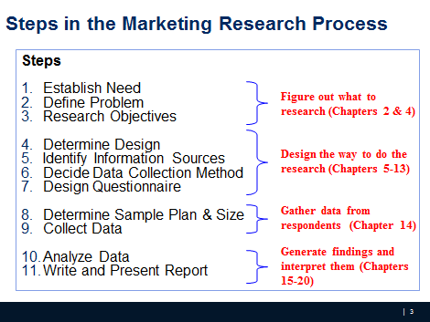
Where we are

Slide 22
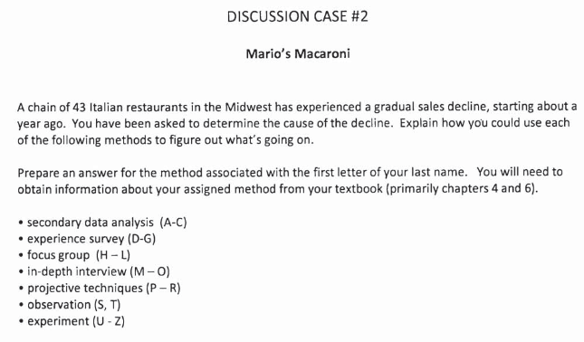
Discussion Case #2
iCliker - write your answer in 2-3 sentences on iClicker
Notes:
What could be the potential causes that a restaurant is having a gradual sales decline? Pick a specific method and consider the probable cause

Slide 23
Research Design
Research design is a set of advance decisions that make up the master plan specifying methods and procedures for collecting and analyzing the needed information

Slide 24
Types of Research Design
The choice of the most appropriate design depends largely on the objectives of the research and how much is known about the problem

Slide 25
Types of Research Design
Three traditional categories/methods:
Exploratory
Descriptive
Causal
Notes:
When we did text mining in the first session, what would you call it?

Slide 26
Exploratory Research
Exploratory research is most commonly unstructured, informal research that is undertaken to gain background information about the general nature of the research problem
By unstructured, we mean there is no formal set of objectives, sample plan, or questionnaire.

Slide 27
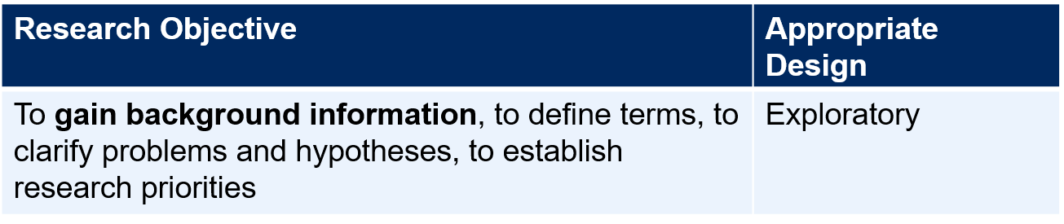
Exploratory Research (Qualitative Research)
Many questions; many sources
Defining the problem; getting a “feel”
Goal: generate ideas (e.g., what, why) for descriptive and exploratory research ( quantitative research). See example.
Uses:
Gain Background information
What is a bank image study?
Define Terms
What terms are used?
Clarify problems and hypothesis
What type of bank customers? Retail? Commercial? Correspondent banks?
Establish Research Priories
Notes:
RQ: What criteria do household use when selection department store. Why do they do so?
See the talking points with client

Slide 28
Research Design: Exploratory Research
A variety of methods are available to conduct exploratory research
Ethnography: Living the experience, observation without interference
Case Analysis
Focus Groups: Talk to people to get their opinion
Secondary data analysis
Others (Depth Interview, protocol analysis, projective techniques)

Slide 29
Focus Groups
Focus groups are small groups of people brought together and guided by a moderator through an unstructured, spontaneous discussion for the purpose of gaining information relevant to the research problem

Slide 30
Types of Focus Groups
Traditional: Select 6 to 12 people and meet in a dedicated room with one-way mirror for client viewing, for about two hours
Nontraditional: Online with 25-50 respondents, allow clients participate

Slide 31
Pros and Cons of Focus Groups
Pros:
Generate fresh ideas
Allow clients to observe their participants
May be directed at understanding a wide variety of issues
Allow fairly easy access to special respondent groups
Cons:
Representativeness of participants
Interpretation sometimes difficult
High Cost per participant
Cannot be used for prediction

Slide 32
Interview guide (for meeting with the client)
1. What is the product/service being provided?
2. What is special 'unique about the product/service?
3. Does the client know who their competition is?
4. Is there a special group of people (such as college students) that the product/service is meant for? Are there different groups of people that the client thinks uses their product/service?
5. Does the client think the different groups think of their product/service differently?
6. What information does the client hope to get from this project? Do they want this information?
7. What are the different things that the client wants to know? Prioritize these questions.
8. What decisions will the client make using the information above? There should be several alternatives that you should get from the client for this decision- e.g., where to advertise their product is the decision that will be aided by your project. The decision alternatives would be advertised in Add Sheet, Columbia Tribune, Missourian, Radio, Television etc.
Notes:
(Point 1- 3 for identifying the problem and causes, point 4-5: target customers and difference type RQ, point 6-7: info needs to form your research objections and their prioritization, point 8: decision alternatives).

Slide 33
Descriptive Research
Descriptive research is undertaken to describe answers to questions of who, what, where, when, and how.
Descriptive research is desirable when we wish to project a study’s findings to a larger population, if the study’s sample is representative

Slide 34
Descriptive Research
Goal: quantify the responses (e.g., how much?What percent?)
Example: questionnaire/ survey
Uses
Measure performance
How is the bank doing in terms of customer satisfaction?
Assess market related phenomena
Why people prefer brand X over Y
Research Objective | Appropriate Design
To describe and measure marketing phenomena at a point in time | Descriptive

Slide 35
Vague research question for survey research
CE1

Slide 36
Research Design: Descriptive Research
Cross-sectional: measure units from a sample of the population at only one point in time. E.g., Survey
Longitudinal: repeatedly measure the sample over time. E.g., Panels (continuous vs. discontinuous)
Notes:
Two basic classifications:
Cross-sectional: measure units from a sample of the population at only one point in time. E.g., Survey
Longitudinal: repeatedly measure the sample over time. E.g., Panels (continuous vs. discontinuous)

Slide 37
Marketing Research Panels
Continuous panels ask panel members the same questions on each panel measurement. Uses – Brand tracking studies, measure change in consumer attitude, behavior etc.
Discontinuous panels (also known as Omnibus) vary questions from one panel measurement to the next. Uses – provide a very broad sample

Slide 38
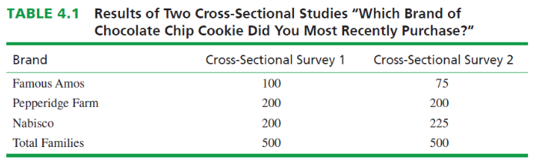
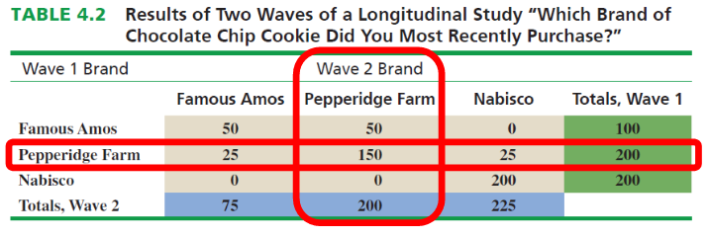
Marketing Research Panels - does Pepperidge Farm need to worry about its competitors?

Slide 39

Causal Research
Causality may be thought of as understanding a phenomenon in terms of conditional statements of the form “If x, then y.”
Causal studies are conducted through the use of experiments

Slide 40
Causal Research
Uses
To find causes
What makes movies like “The Dark Knight Rises” appeal to masses
Does background music affects purchase behavior
Research Objective | Appropriate Design
To determine causality, to make “if- then” statements | Causal

Slide 41
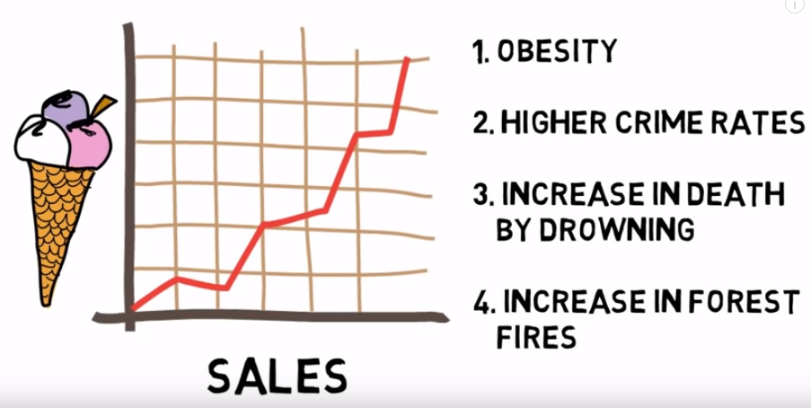
Causality – or is it really?

Slide 42
Research Design: Causal Research
An experiment is defined as manipulating an independent variable to see how it affects a dependent variable, while also controlling the effects of additional extraneous variables.
Two Types of Experiments
Laboratory Experiment
Field Experiment

Slide 43

Example of Causal Research: Test Marketing
Test marketing is the phrase commonly used to indicate an experiment, study, or test that is conducted in a field setting.
Uses of test markets:
To test sales potential for a new product or service
To test variations in the marketing mix for a product or service

Slide 44
Independent Variable
Independent variables are those variables which the researcher has control over and wishes to manipulate. (E.g., level of ad expenditure; type of ad appeal; price; product features, etc.)

Slide 45
Dependent Variable
Dependent variables are those variables that we have little or no direct control over, yet we have a strong interest in. E.g., return on investment (ROI), net profits, market share, customer satisfaction.

Slide 46
Extraneous Variables
Extraneous variables (control variables) are those
variables that may have some effect on a dependent
variable yet are not independent variables.
Extraneous variables must be controlled through proper experimental design.

Slide 47
Experimental Design
Experimental design is a procedure for devising an experimental setting such that a change in a dependent variable may be attributed solely to the change in an independent variable.
iClicker: how would you design an experiment to assess if the ‘buy one get one free’ on shoes promotion increases the sale during Christmas?

Slide 48
Experimental Design
Experimental group (R) O1 X O2
Where Effect: (O2 - O1)

Slide 49
Experimental Design
Experimental group (R) O1 X O2 Control group (R) O3 O4
Where E: (O2 - O1) - (O4-O3)

Slide 50
Pretest and Posttest
Pretest refers to the measurement of the dependent variable taken prior to changing the independent variable (IV)
Posttest refers to the measurement of the dependent variable after changing the independent variable (IV)

Slide 51
Validity
Internal Validity: the extent to which the researcher is certain that a change in a dependent variable is actually due to the independent variable
External validity is taken care of if the test and control groups are representative

Slide 52
Recap – iClicker poll
Research Design:
Master plan of how to go about collecting and analyzing information
Types of Research Design:
Exploratory
Descriptive
Causal
Examples??
Notes:
There are basic marketing research designs that can be successfully matched to given problems and research objectives, and they serve the researcher much like the blueprint serves the builder.

Slide 53
What’s coming?
Answer to vague RQ in CE1
Discussion case #3
PA3

Slide 54
5-min Snippet

